Slide 1
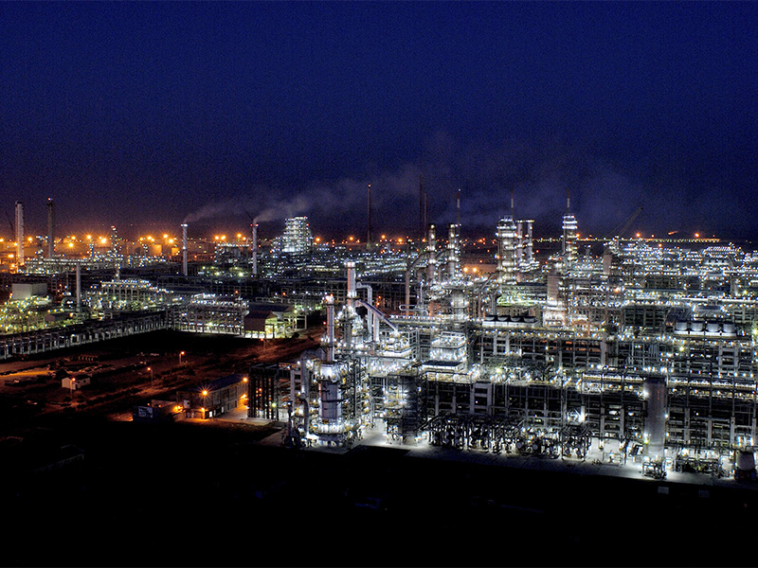

Study Project on ROGC Furnace
Submitted by - SAHIL MOHAL
EP ID - 19604387

Slide 2
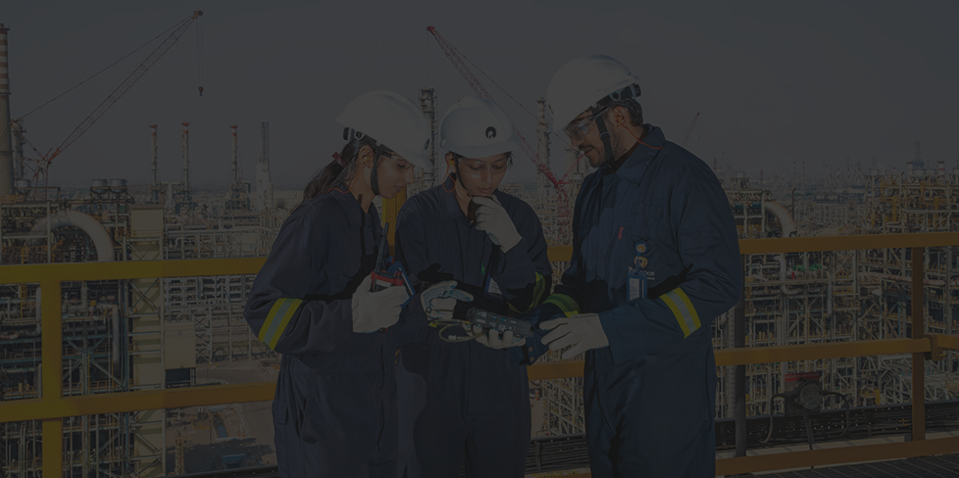
Content
01
Furnace Working Principle & Importance.
02
Coil Revamping
03
ID Fan Operation and Maintenance
04
Furnace and ID Fan Reliability issues

Slide 3

ROGC Overview
ROGC is designed to recover components like ethylene , propylene , ethane , propane and butane from refinery off gas streams .
Ethane and propane are cracked to produce about 180TPH of ethylene and 16TPH of propylene .
The output ethylene and propylene are used as feedstocks for polymer plants (PE/PP), producing materials like LDPE, LLDPE, and PP.

Slide 4

FEED TO ROGC
Feed is sourced from DTA and SEZ in form of Saturated and unsaturated gas.
Saturated gas comes from CDU and hydrotreater of SEZ and DTA refinery
Unsaturated Gases are off gases from FCC and coker
Three separation trains
Saturated gas processing train
Unsaturated gas processing train
Cracker train

Slide 5
In a Refinery Off-Gas Cracker (ROGC), the process is broadly divided into two main Areas
Hot Section
Cold Section
This is where the thermal cracking of saturated hydrocarbons occurs to produce olefins like ethylene and propylene.
This includes Feed Preheating ,Cracking furnaces ,Quench system ,Primary fractioners.
This section separates the desired olefins (ethylene, propylene, butadiene) from non-condensables and other hydrocarbons using cryogenic distillation.
This includes Compression Trains, drying , cryogenic separation.

Slide 6
FURNACE
A furnace is a thermal device used to generate heat by burning fuel or using electricity. It transfers the generated heat to a process material, fluid, or feedstock for industrial purposes such as heating, melting, or chemical reactions.
Basic Working Principle
Fuel Combustion: Fuel (e.g., natural gas) burns with air in burners, generating high-temperature flue gases.
Heat Transfer: Heat is transferred to the target material either directly or through heat exchangers.
Exhaust Removal: Flue gases are discharged via chimneys or stacks, often aided by an Induced Draft (ID) fan.

Slide 7
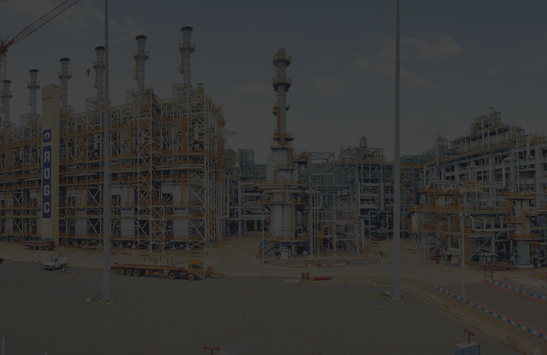
Furnace in ROGC plant
In a Refinery Off-Gas Cracker (ROGC), the furnace is the core component responsible for thermal cracking of hydrocarbon feedstock into valuable petrochemicals like ethylene, propylene.
Furnaces are designed to crack – Ethane ,propane , Ethane + Propane
Furnace Capacity
No of furnaces – 6 + 1 demo
Individual furnace capacity – 200KTA
Heat Duty – 110 MMkcal/h (per furnace )
Furnace Licensor -Technip

Slide 8
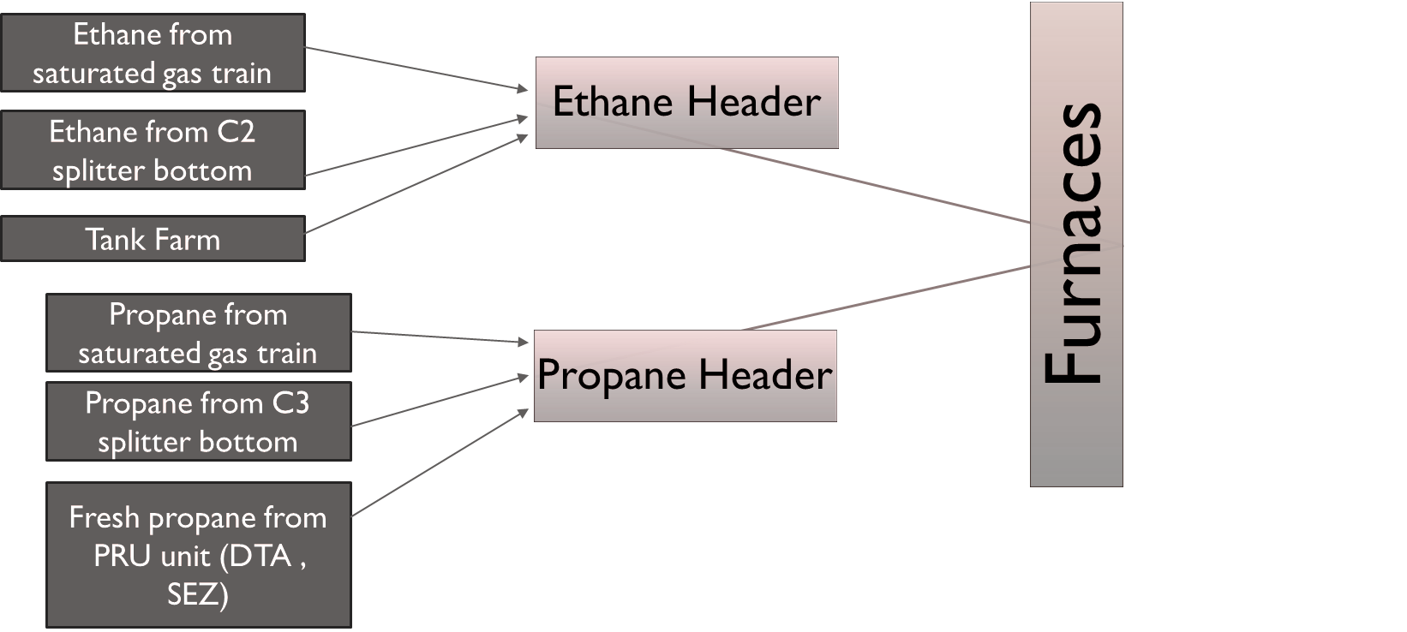
FEED

Slide 9
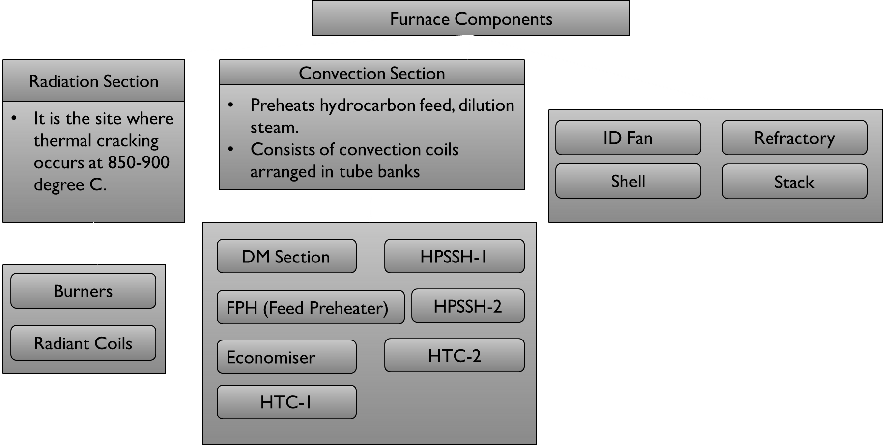

Slide 10
Convection Section - Design Parameters
Equipment | Inlet | Tubes | Outlet | Tubesheets (Bottom/Top)
DM Demin water pre-heater | SS316L 135°C / 23 kg/cm²g | SS316L / fins – 18Cr8Ni fins - 360°C | SS316L 165°C / 23 kg/cm²g | 360 / 360°C
FPH Feed pre-heater | CS 400°C / 8.1 kg/cm²g | CS / fins fins - 400°C | CS 400°C / 8.1 kg/cm²g | 400 / 400°C
ECO Economizer | CS 330°C / 129 kg/cm²g | CC / fins CS fins 415°C | CS 330°C / 129 kg/cm²g | 475 / 300°C
HTC-1 Feed & Steam pre-heater | 2.25Cr 360°C / 7.0 kg/cm²g | P22 / fins 11–13Cr fins 635°C | 2.25Cr 525°C / 7.0 kg/cm²g | 650 / 620°C
HPSSH-I Steam super-heater | CS 330°C / 125 kg/cm²g | 1.25Cr 0.5Mo (P11) SS347H / fins 18Cr8Ni fins - 635°C | SS347H 530°C / 125 kg/cm²g | 760 / 675°C
HPSSH-II Steam super-heater | SS347H 530°C / 125 kg/cm²g | SS347H 645°C / 125 kg/cm²g | SS347H 540°C / 125 kg/cm²g | 875 / 800°C
HTC-II Feed & Steam pre-heater | 2.25Cr 525°C / 6.5 kg/cm²g | SS347H 20Cr33Ni 950°C / 6.5 kg/cm²g | SS347H 780°C / 6.5 kg/cm²g | 1180 / 935°C

Slide 11

BURNERS
There are 48 bottom burners(24 are pilot burners ) and 48 side burners (24 on each side ).
They are flat flamed i.e uniform heat distribution
Max available combustion air pressure at burner – Atmospheric.
Allowable Emissions are – Nox , CO, Sox and particulates .
They provide the heat source by combusting fuel(Methane ) in presence of air .
GLSF-8 burners are low-NOx, floor-fired burners widely used due to their high efficiency, stable flame characteristics, and environmentally compliant design

Slide 12
RADIANT COILS
Tubes carrying hydrocarbon feed are placed in the radiant section to absorb heat through radiation.
These are typically made of high-temperature resistants Ni, Cr Alloys . There are total 40 no’s W coil which consist 160 no’s of Tubes per Furnace .
The flow pass thru a venturi nozzle into the radiant coils .
Residual time :- Propane – 0.55 sec , Ethane -0.65 sec

Slide 13
TLE’s
Working Principle
Hot process gas flows through inner tubes
Boiler feedwater flows in annular space between inner and outer tubes
Generates high-pressure steam
Double tube heat exchangers designed to recover heat from hot cracked gases exiting the radiant section.
Types
PTLE: Primary Transfer Line Exchanger
STLE: Secondary Transfer Line Exchanger
TTLE: Tertiary Transfer Line Exchanger

Slide 14
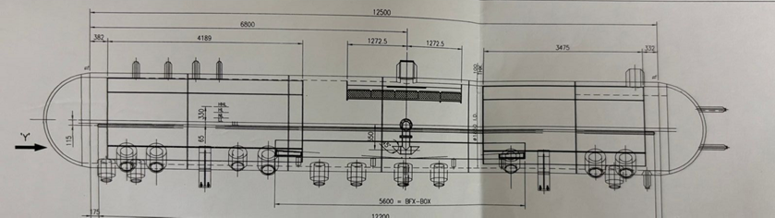
STEAMDRUM
(Vendor- Thermax Limited Boiler and heater Group)
Acts as a reservoir for water and steam separation
Gets pre heated Steam from Economiser and steam generated in TLE’s at 310 degrees .
Design Data
Steam Flow Rate Out -92228 kg/h
Operating Pressure – 109.6 kg/cm2 (design P -125 kg/cm2)
Operating Temperature -317 degrees C (max 330 degrees C)
Volume -37 m3
Insulation Thickness-165mm

Slide 15
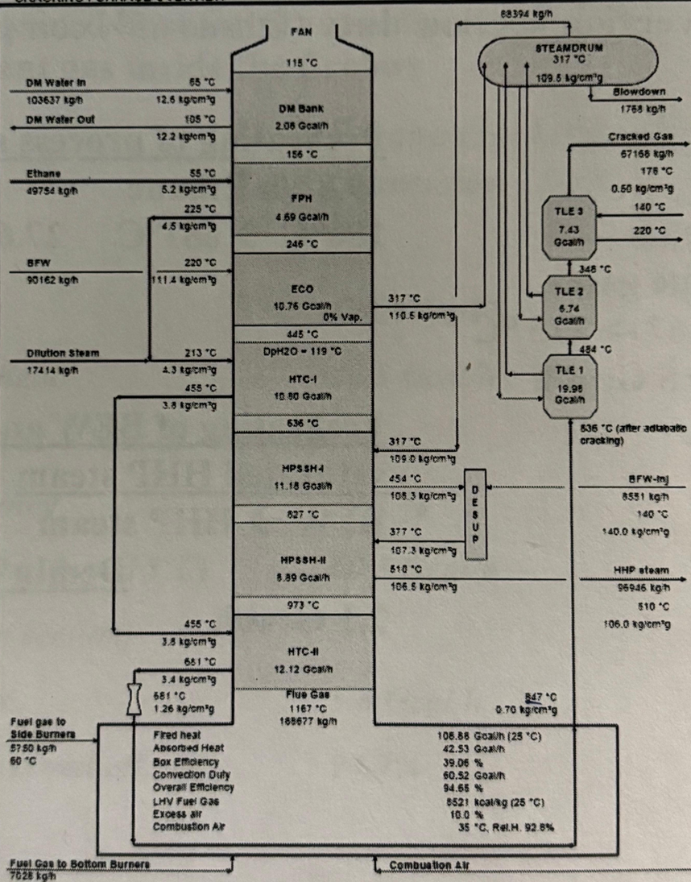
Process FLow Diagram

Slide 16
Coil Revamping
 | inlet | #1 | #2 | #3 | #4 | outlet
material | 18Cr10NiNb | 25Cr35NiNb MA | 25Cr35NiNb MA | 35Cr45NiNb MA | 35Cr45NiNb MA | 20Cr33NiNb
ID x MSW (mm) | 90 x 7.0 | 90 x 7.0 | 90 x 7.0 | 100 x 7.0 | 100 x 7.0 100 x 8.0 | 100 x 8.0
DT (°C) | 780 | 1080 | 1080 | 1115 | 1115 | 910
DP (kg/cm2g) | 6.5 | 4 | 3.9 | 3.6 | 3.3 | 3.3
TMT (SOR) °C |  | 966 | 976 | 992 | 1002
TMT (EOR) °C |  | 1011 | 1042 | 1065 | 1092
Previous Coil Configuration
In ROGC plant , total 6 main furnaces are having Kubota make coils :-

Slide 17
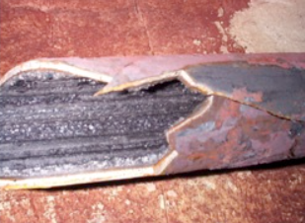
Why do we need ravamping ?
Radiant Coils undergo defetcts such as :-
Sagging and Bowing
Oxidation and scaling
Bulging and Creep
Corrosion
Carburization
Carburization
Carburizing or carburization is a heat treatment process in which iron or steel absorbs carbon while the metal is heated in the presence of a carbon-bearing environment. Carbon migrates into crystal structure of coil.
This results in loss of ductility

Slide 18
Progressive % Carburization (Max.)
Sr. No | Furnace | Make | Commissioning Date | 2018 | 2019 | 2020 | 2021 | 2022
1 | F010001 | Kubota | Sep 1, 2017 | 0 |  |  | 18.44 | 33.14
2 | F010002 | Kubota | Sep 1, 2017 | 0 |  |  | 18.44 | 44.21
3 | F010003 | Kubota | Sep 1, 2017 | 0 |  | 10.5 | 14.02
4 | F010004 | Kubota | Sep 1, 2017 | 0 |  | 9.4
5 | F010005 | Kubota | Sep 1, 2017 | 0 |  | 15.14 | 27.8
6 | F010006 | Kubota | Sep 1, 2017 |  | 4.6 | 14 |  | >50

Slide 19

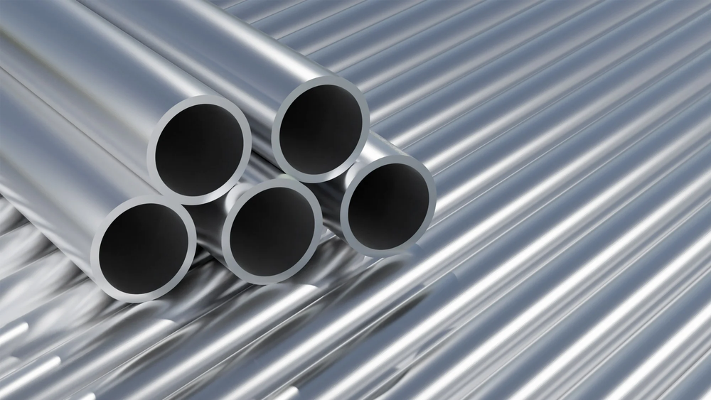
Revamp Methodologies
In NPV (Net Present Value Analysis) Aluminum containing (HT-E Al alloy ) coil is found benificial
Life of 7-8 years due to less coking and carburization.
Aluminium forms a stable alumina (Al₂O₃) layer on the coil surface.
This layer is smooth, dense, and has low catalytic activity, thus reducing coke formation.

Slide 20
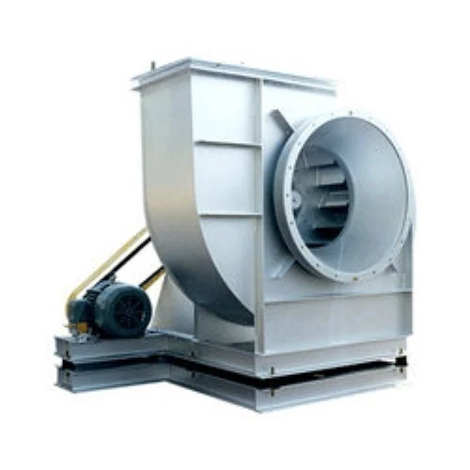
ID FAN
Manages the flow of flue gases through the system.
Located near the base of stack .
Creates a negative pressure inside the furnace, ensuring a steady draft that promotes efficient combustion

Slide 21
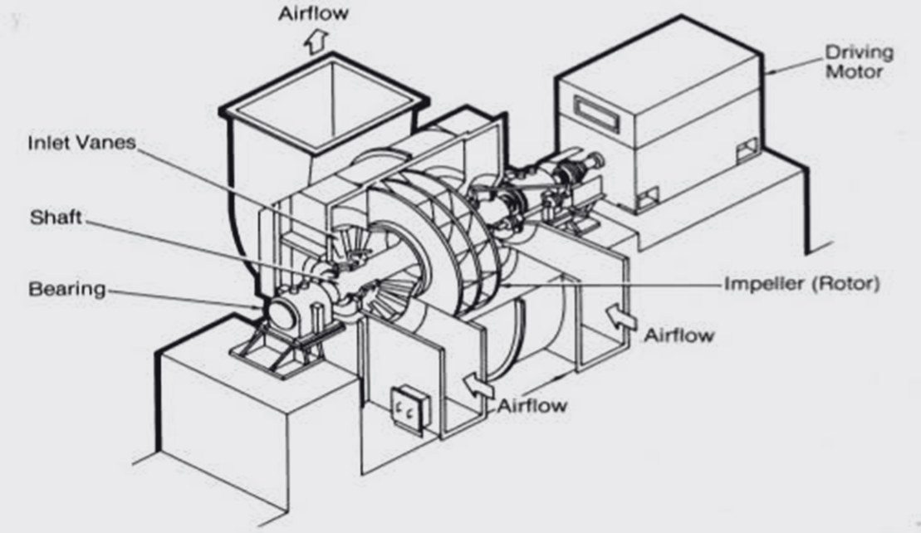
ID FAN Basic Components

Slide 22
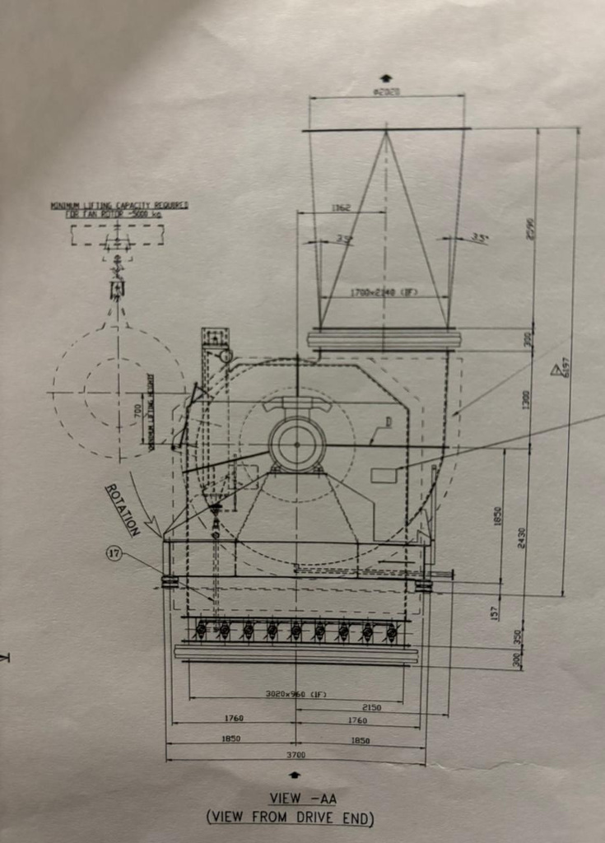
Equipment Description
EQUIPMENT Type | ID FAN
EQUIPMENT TAG NO | MA-CRC-301-F010001/2/3/4/5/6
MODEL NO | 80W/L170M DWDI
EQUIPMENT MAKE | AEROTTO BOLDROCCHI

Slide 23
Parameter | Design | Normal
Mass flow rate kg/hr | 232295 | 193579
Volume flow rate (m3/sec) | 82.726 | 64.014
Density at Temp (kg/m3) | 0.84 | 0.78
Temp (degree C) | 142 | 117
Static Pressure inlet (mmWC) | -136.9 | -86.9
Static Pressure Outlet (mmWC) | 20.8 | 12.2
Rpm | 750 | 620
Rated Power |  | 200W
Fan Efficiency | 79.50% | 79.50%
Operating Conditions

Slide 24
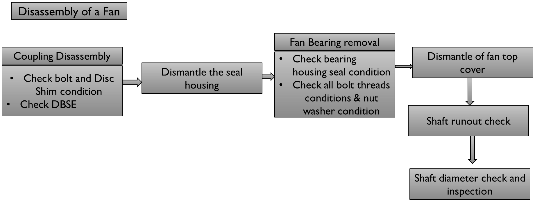
Maintanence ID FAN

Slide 25
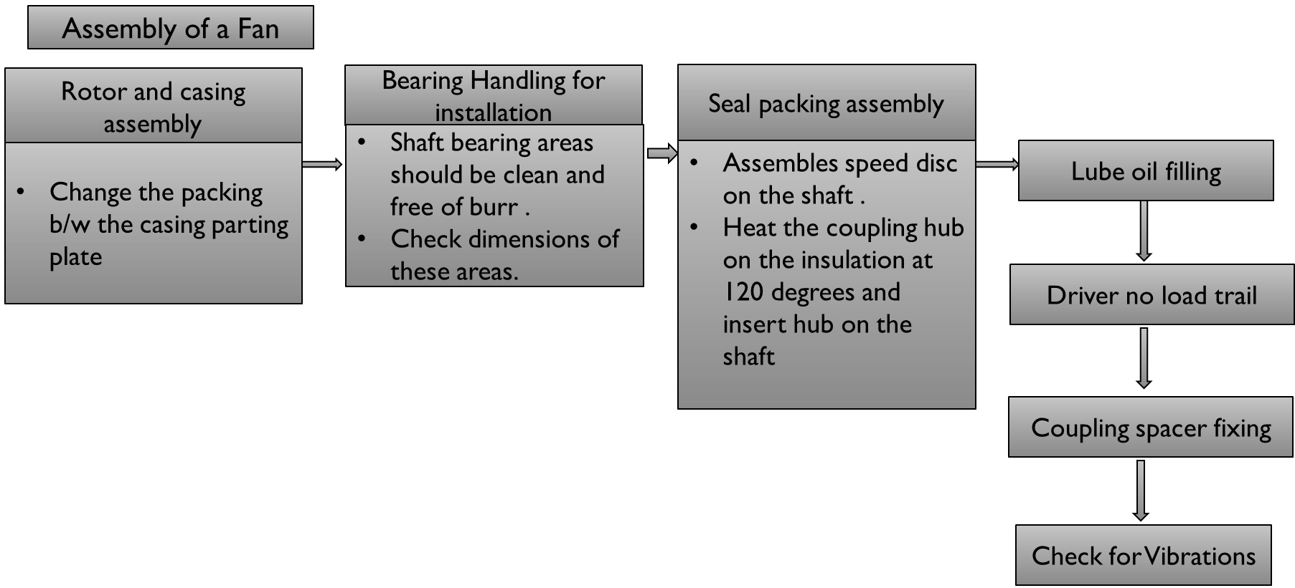
Maintanence ID FAN

Slide 26
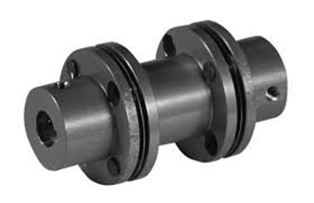
ID Fan Coupling Failure – Furnace-4 (Sep 26, 2024)
Event
Mechanical failure of ID fan coupling at Furnace-4 caused a complete shutdown.
Trigger
High draft pressure alarm (noted at approximately -2 ) led to inspection and discovery of coupling spacer damage1.

Slide 27

Equipment And Operations
ID Fan Role
Maintains induced draft to regulate furnace pressure, driven by VFD-controlled motor.
Key Specs
•Mass Flow: 2,32,295 kg/hr
•Volume Flow: 87.7 m³/sec
•Design Temp: 142°C
•Air Density: 0.78 kg/m³
Draft Pressure
Operates slightly below atmospheric; alarm triggered at high vacuum (around -2 inH2O).

Slide 28
INCIDENT PROGRESSION
High draft pressure alarm triggers shutdown.
Inspection finds damaged coupling spacer.
Temporary repairs allow restart; abnormal vibration and noise persist.
Further checks reveal bolt failures, misalignment, and fatigue cracks.

Slide 29
TECHNICAL FINDINGS
Vibration Analysis
Fan operated near critical harmonic speed at 250 RPM.
Campbell diagram revealed resonance at 697 RPM (2X), and at 348, 232, 116 RPM (4X, 6X, 12X subharmonics).
Mechanical Effects
Spacer and bolts showed fatigue cracks from cyclic stress and resonance.
Torsional fatigue caused by prolonged operation within excitation zones.

Slide 30
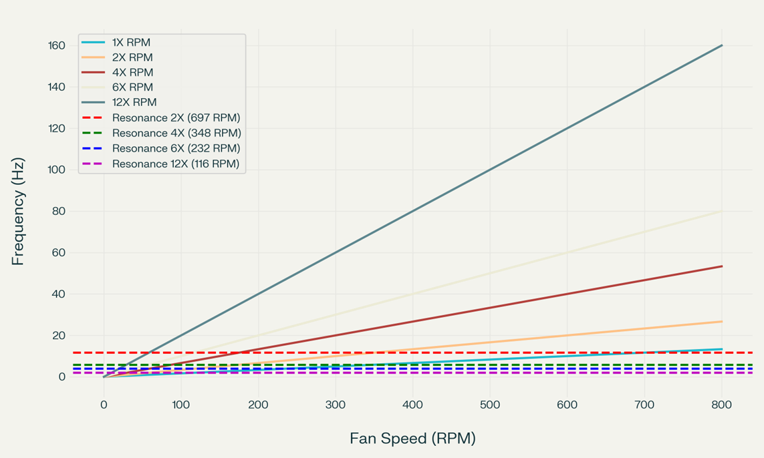
CAMPBELL
DIAGRAM

Slide 31
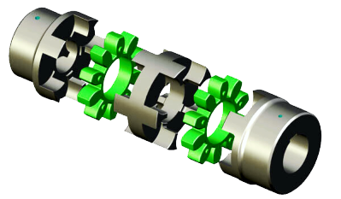
PREVENTIVE MEASURES
Hardware
Replace disc pack coupling with rubber or spider-type coupling to absorb torsional vibration.
Operation
Rapidly ramp up fan speed to avoid resonance zones (250–450 RPM, 550–560 RPM, 660–700 RPM, 670–695 RPM)1.
Monitoring
Implement real-time vibration measurement and regular inspection.
Draft Pressure
Maintain draft pressure within safe limits to prevent recurrenc

Slide 32
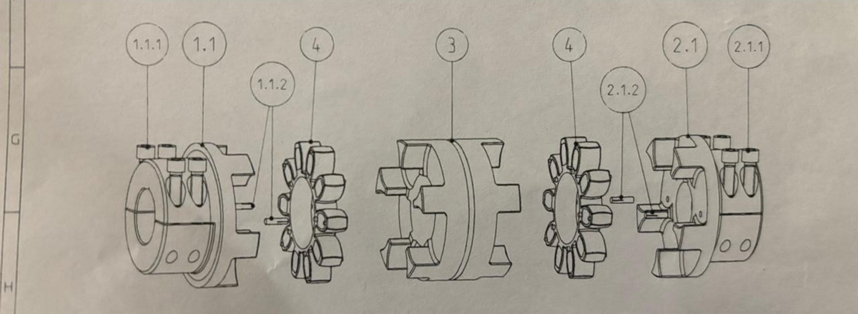
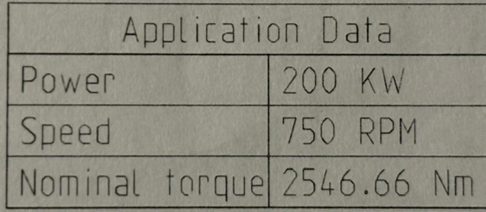
Spider Coupling Design Limits

Slide 33
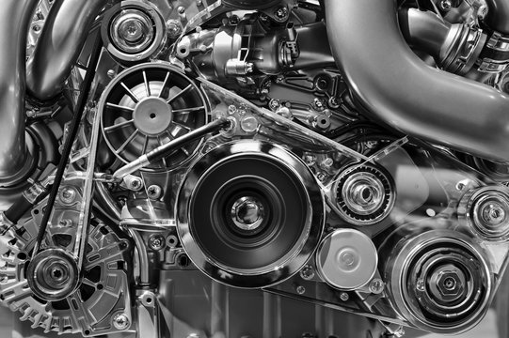
Furnace-04 ID Fan Motor Tripping Incident
Event
On June 14, 2024, the ID fan motor of Furnace #04 tripped due to an earth fault, causing the furnace to enter cold standby shutdown mode

Slide 34
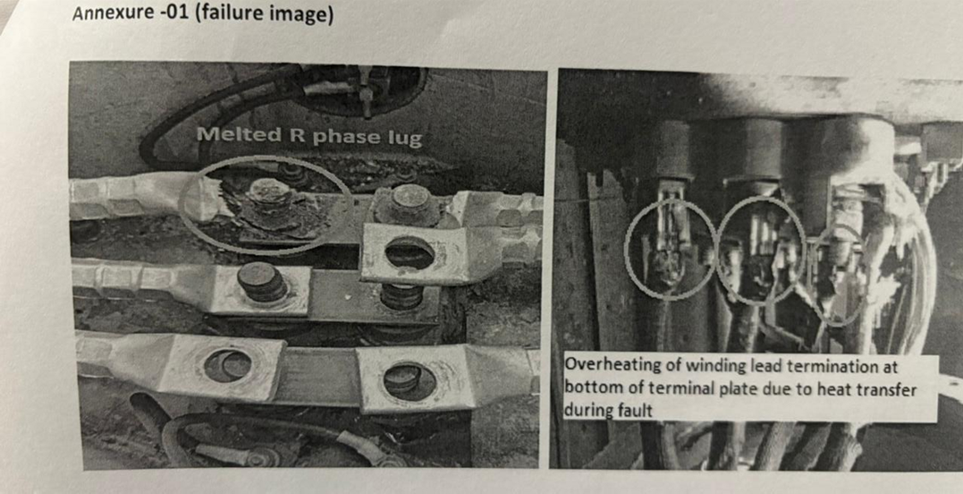
OBSERVATION AND WHY IT HAPPENED
Insulation resistance checks showed zero resistance, confirming an earth fault.
Inspection found the R-phase cable lug overheated; the terminal nut melted and detached.
The loose cable made contact with the motor body, causing the earth fault.
Minor overheating on the winding lead, but motor winding was undamaged.
MAIN CAUSES
Loose cable lug connection created high resistance and heat.
Aluminum lug and brass terminal link may have contributed to heating (material mismatch), but no corrosion was found1.

Slide 35

MEASURES TAKEN
Faulty motor replaced with a tested spare.
Cables properly aligned and re-terminated.
System tested and returned to operation.
PREVENTIVE STEPS
Use bimetallic washers between aluminum lugs and brass terminals.
Consider upgrading to copper cables.
Ensure all cable lugs are tightened to recommended torque.
Schedule regular thermal imaging checks every 4 weeks1

Slide 36

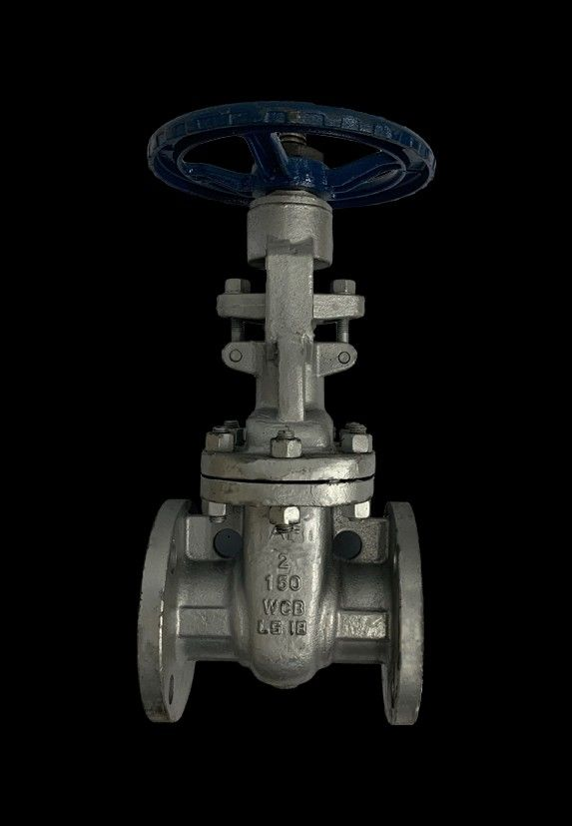
VALVES
A valve is a device used to permit or restrain the flow of fluid or adjust the pressure in a system.
A complete control valve consists of the valve itself, an actuator (provides force to open/close), and a valve control device (ensures proper operation, positioning, and response interpretation).

Slide 37
Valve Types
Ball Valve
Valve with a spherical disc , the sphere has a hole in it which when it comes in line with the pipe it makes connection open .
Butterfly Valve
Consists of disc attached to shaft with bearing used to felicitate rotation ,
Globe Valve
Globe valves are a type of linear motion valve primarily used to start, stop, and regulate flow in a pipeline.
Plug Valve
Plug valves are quarter-turn valves used to start or stop flow in pipelines

Slide 38
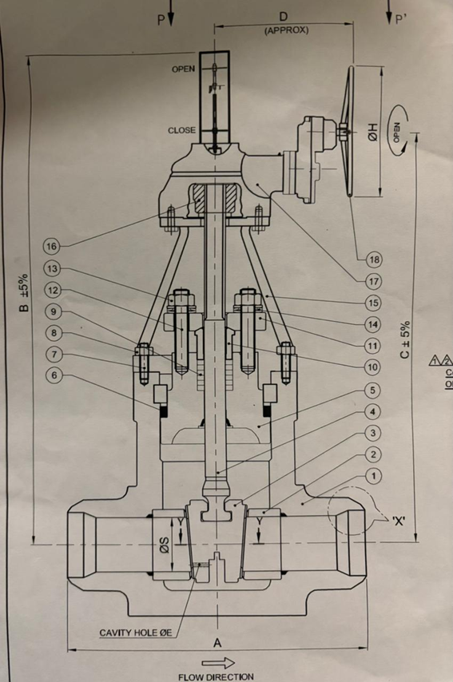
ZS LINE VALVE
Valve Type– Isolated Wedge valve
Vendor Name – L&T Valves
EQ No – VG8ARANC -20“
Pipe size – 20 inches
Weight of the valve – 6100kg
METALLURGY
Body | ASTM A336 GR F91
Stem | ASTM A182 GR F6A
Packing (Before the issue) | Graphite Rings With Corrosion Inhibitor
Gland | ASTM A276 TYPE 410

Slide 39
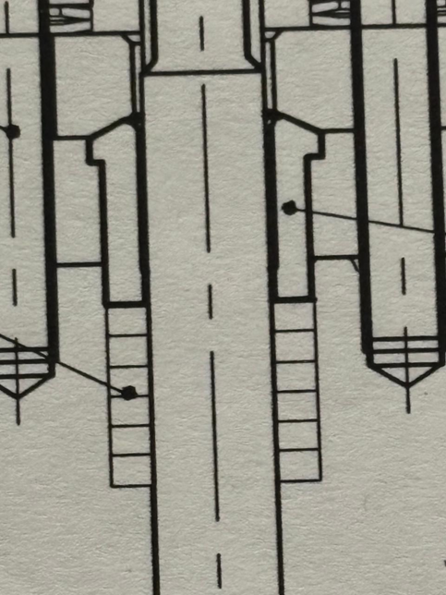
GLAND
STEM
GLAND PACKING

Slide 40
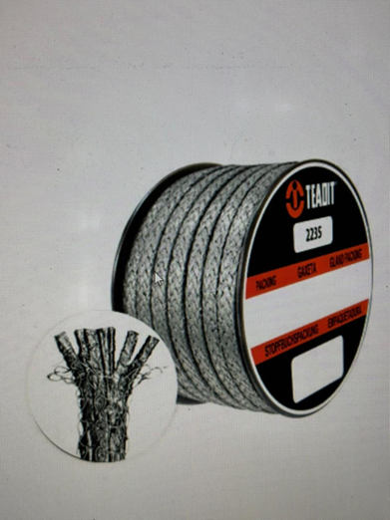
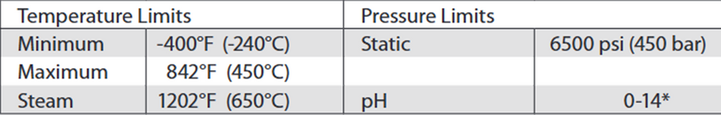
TEADIT 2236
Made of layers of flexible graphite in compact form .
Inconel wire jacket as a reinforcement
Contains PTFE fillers
ISSUE
Gland packing failure and stem corrosion incidentgot noticed during TA2023
Corrosion is attributed due to Fluorine attack
Solution
Use TEADIT 2235 packing instead of TEADIT 2236 .
And the metallurgy of stem and gland remain unchanged

Slide 41
THANK YOU !

